Slide 1

Using Data to Make Informed Decisions
Notes:
Beginning of Presentation

Slide 2
Objectives
Become familiar with health data from www.countyhealthrankings.org
Understand the difference between Health Outcomes and Health Factors
Identify areas of strength and improvement in your county
Understand how to move with data to action
Notes:
Read Slide Objectives
Notate authoritative data from County Health Rankings provided by the Robert Wood Johnson Foundation

Slide 3
Find Data
Analyze Data
Understand Data
Move to Action from Data
Notes:
We developed a model with four key steps with the first being finding authoritative data. There are many online data resources that cannot be trusted. We focus on using County Health Rankings as it is trusted and updated regularly.

Slide 4
Why does Health Matter?
Health directly impacts the Life Expectancy of Humans
Healthier People are generally Happier
Healthy Communities
    Engage in Physical Activity
    Promote Healthy Food Choices
    Encourage Each Other to Live HEALTHY
Notes:
Read Slide

Slide 5
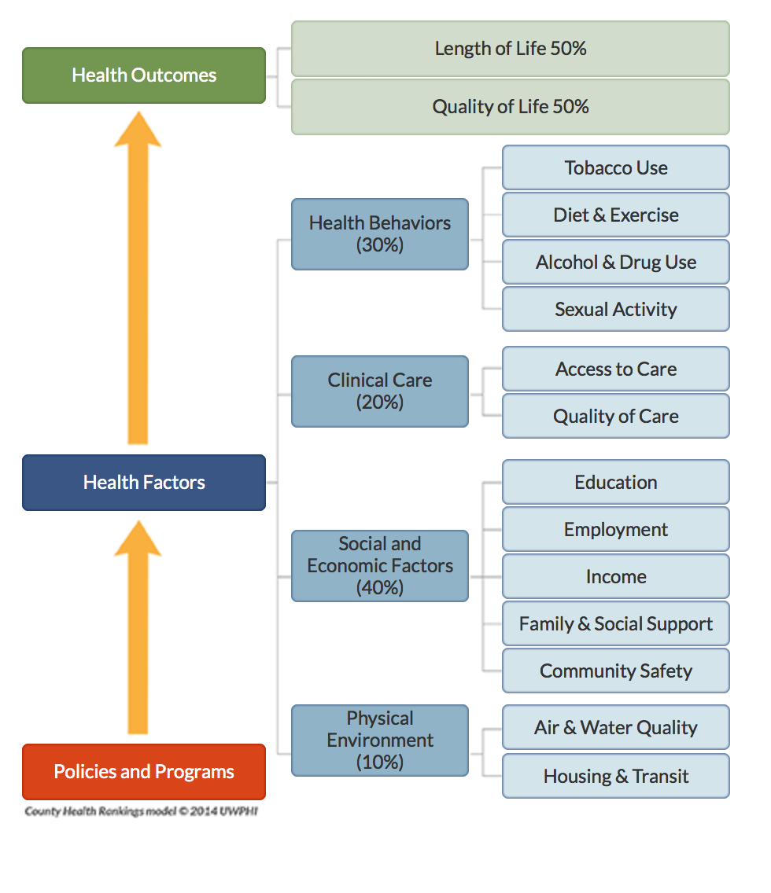

Health Rankings Model
Health Factors modify Health Outcomes.
Notes:
Health Factors are in blue and modify Health Outcomes in green. It is important to note that there are policies and programs that impact health factors which impact health outcomes i.e a chain effect. Read through the different factors and the two outcomes.

Slide 6
Health Factors VS. Health Outcomes
Health Factors are what influence the health of a county. The ranks are based on four types of measures:
- health behaviors
- clinical care
- social and economic
- physical environment factors
Health Outcomes show how Healthy a County is. The healthiest county in the state is ranked #1. The ranks are based on two types of measures: how long people live and how healthy people feel while alive.
Source: http://www.countyhealthrankings.org
Notes:
Read Slide

Slide 7
*COULD*
Health Factors
MODIFY
Health Outcomes
Alcohol Consumption
(Driving)
Automobile Accident
(Premature Death)
Lung Cancer
(Premature Death)
Smoking
Various Problems
(Can Lead to Premature Death)
Adult Obesity
Notes:
Read Slide - Important to note that the health factor modifies the health Outcome

Slide 8
Why Visualize Health Data?
Notes:
Read Slide

Slide 9
Find Data
Analyze Data
Understand Data
Move to Action from Data
Notes:
Re-emphasize the model with visualizing allowing us to better analyze and understand the data.

Slide 10
Visualizing Health Data
Visualizing data allows us to better understand what is happening amongst the data
It gives meaning to numbers
It sparks conversation!
Allows us to find bright spots to learn from and partner with
Notes:
Read Slide

Slide 11
“[Data] helps people see more clearly and make better decisions!”
Charlie Fitzpatrick | Esri Schools Program Manager
Notes:
Read Slide

Slide 12
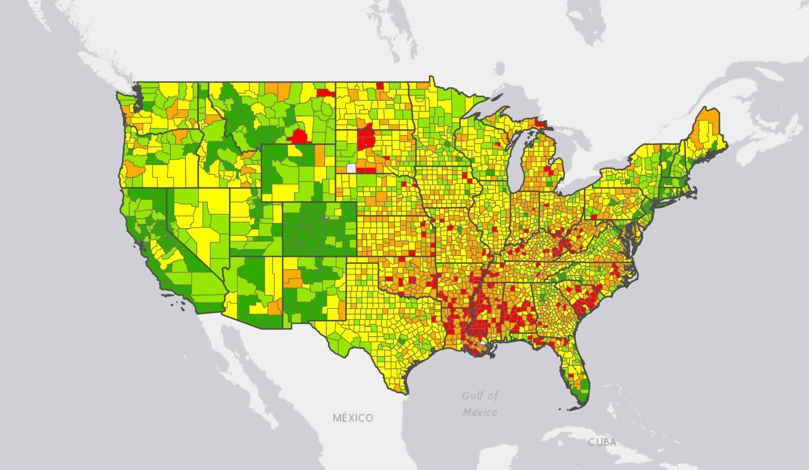
Obesity Rates Across the U.S.
Green = Healthy
Red = Concern
Notes:
This slide shows how one can use GIS (Geographic Information Systems) to visualize obesity data from County Health Rankings. It breaks down obesity rates from green being more healthy to red being concerning. Through this visualization, we can begin to see some trends and patterns in the Southeast and Midwest.

Slide 13
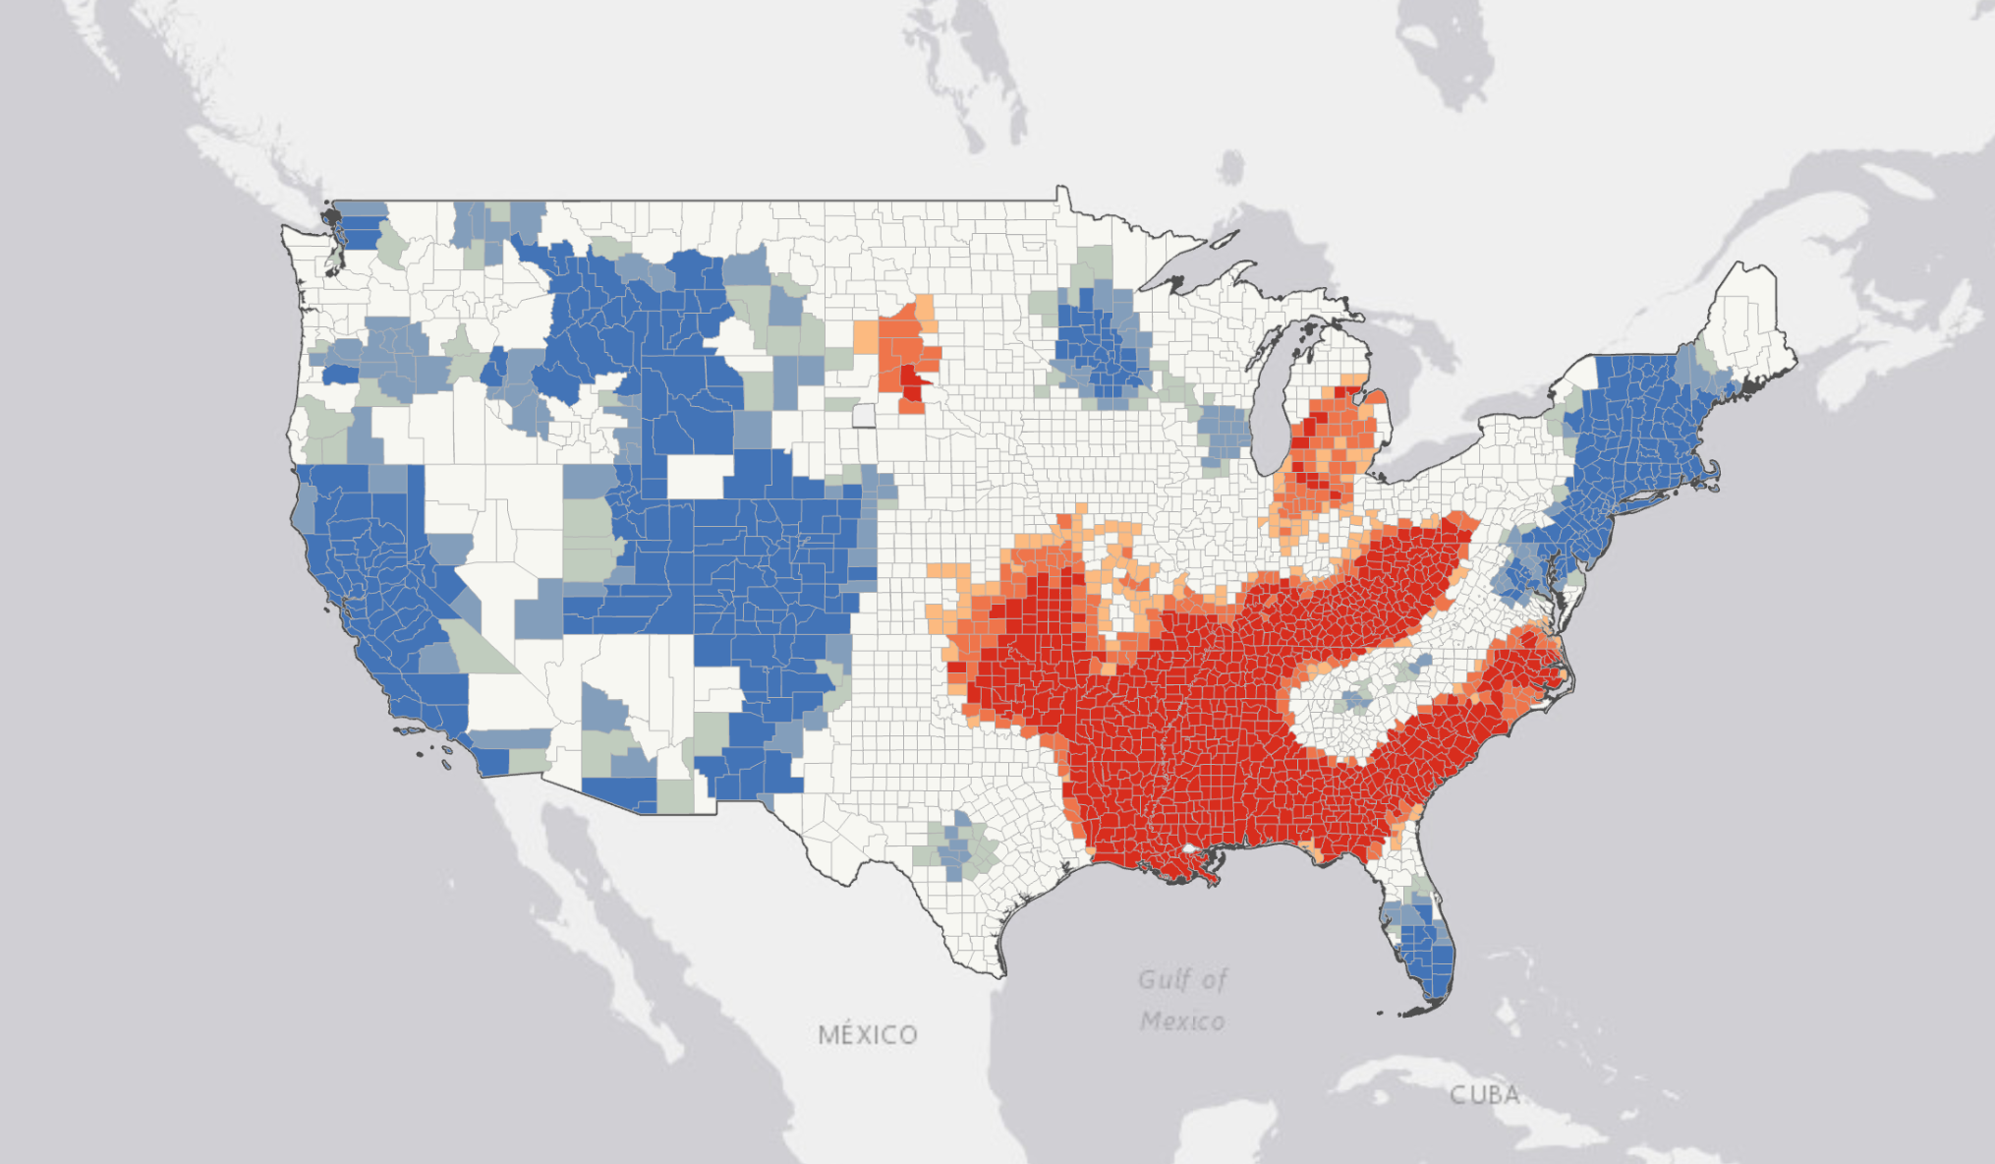
Obesity Hotspots Across the U.S.
Blue = Healthy
Red = Concern
Notes:
This visualization is an extension of using GIS analysis to find hotspots or patterns to focus on. The areas of red are concern with the areas of blue being generally healthy.

Slide 14
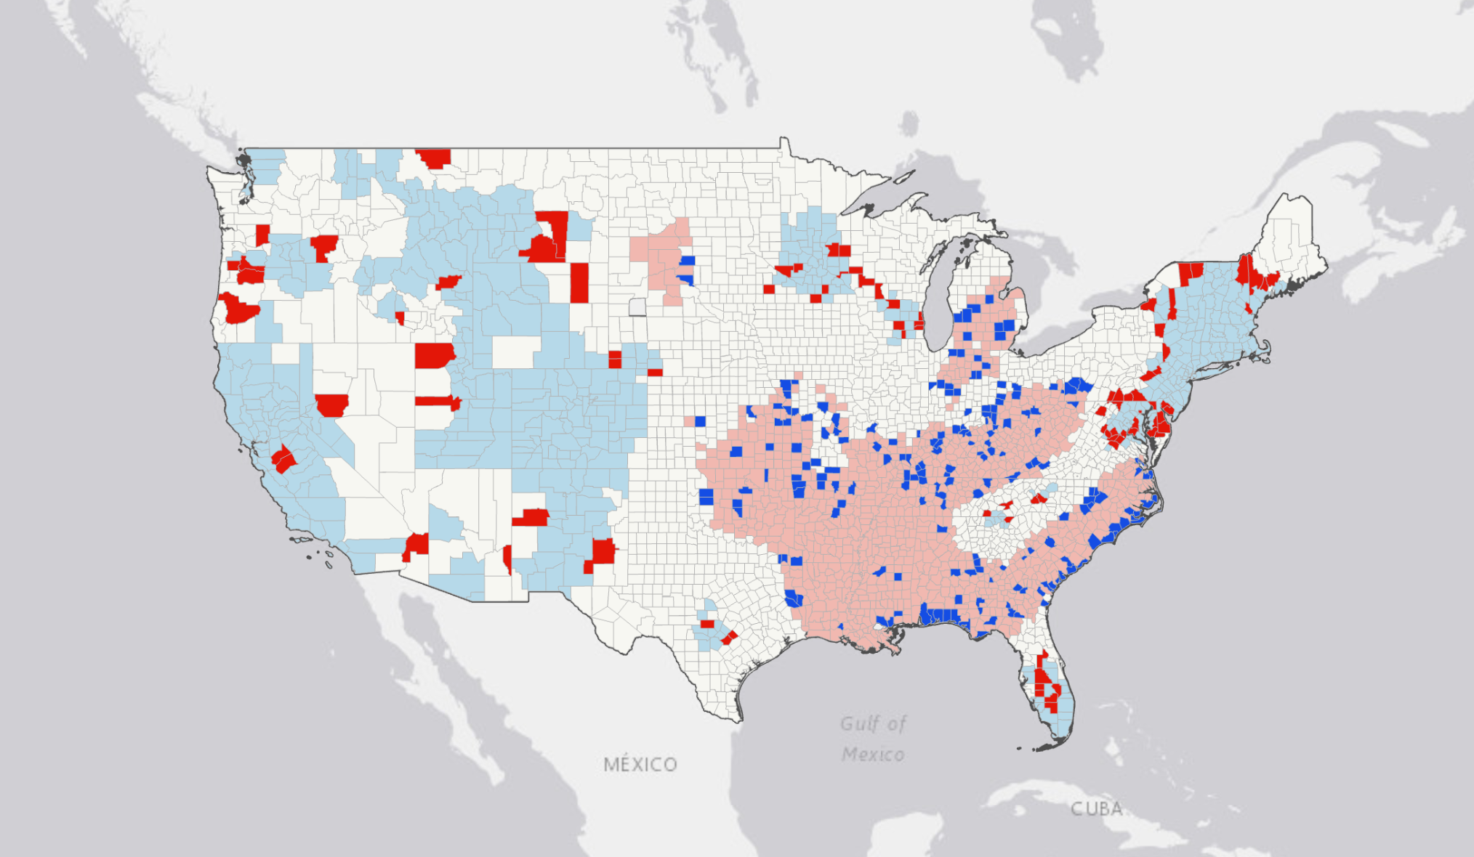
Obesity Outliers Across the U.S.
An outlier is something that stands out or is opposite of what you are looking at!
Blue = Good in area of concern
Red = Bad in area of good
Notes:
This is a third example of using GIS to find outliers amongst the obesity data. We can see areas of blue that are generally healthier compared to the communities around them. On the other hand, the areas in bright red are concerning compared to the communities around them.

Slide 15
Find Data
Analyze Data
Understand Data
Move to Action from Data
Notes:
Read Slide emphasizing Moving to Action from Data

Slide 16
A Look at how Data Sparked
Action
Notes:
Read Slide

Slide 17
Maryland – Using GIS to Spark Action
Notes:
Now let's look at a community in Maryland that moved to action with data

Slide 18
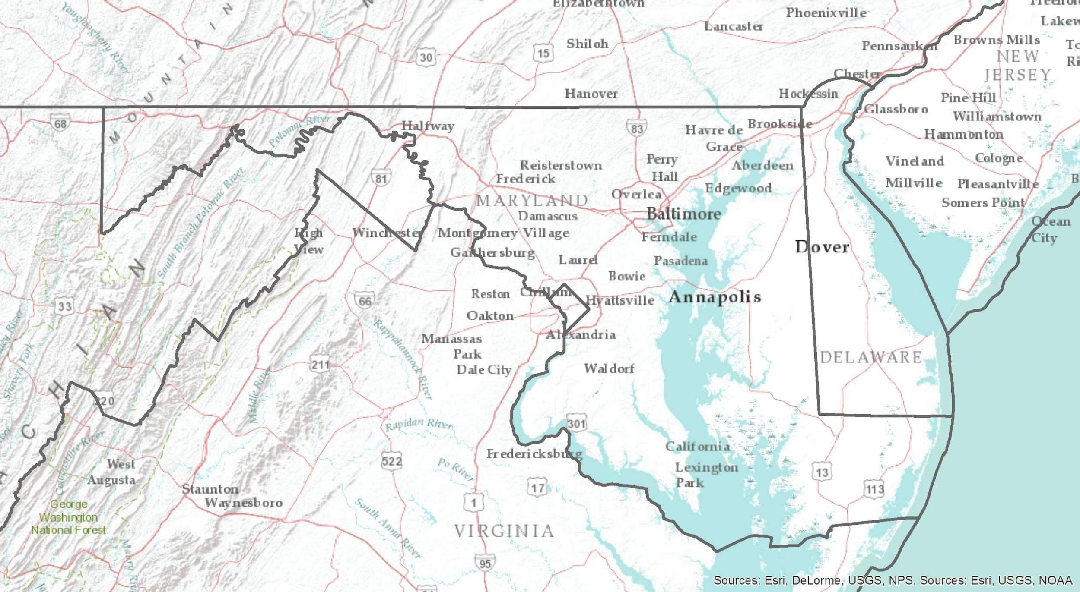
Notes:
Let’s star with a blank map of Marlyland.

Slide 19
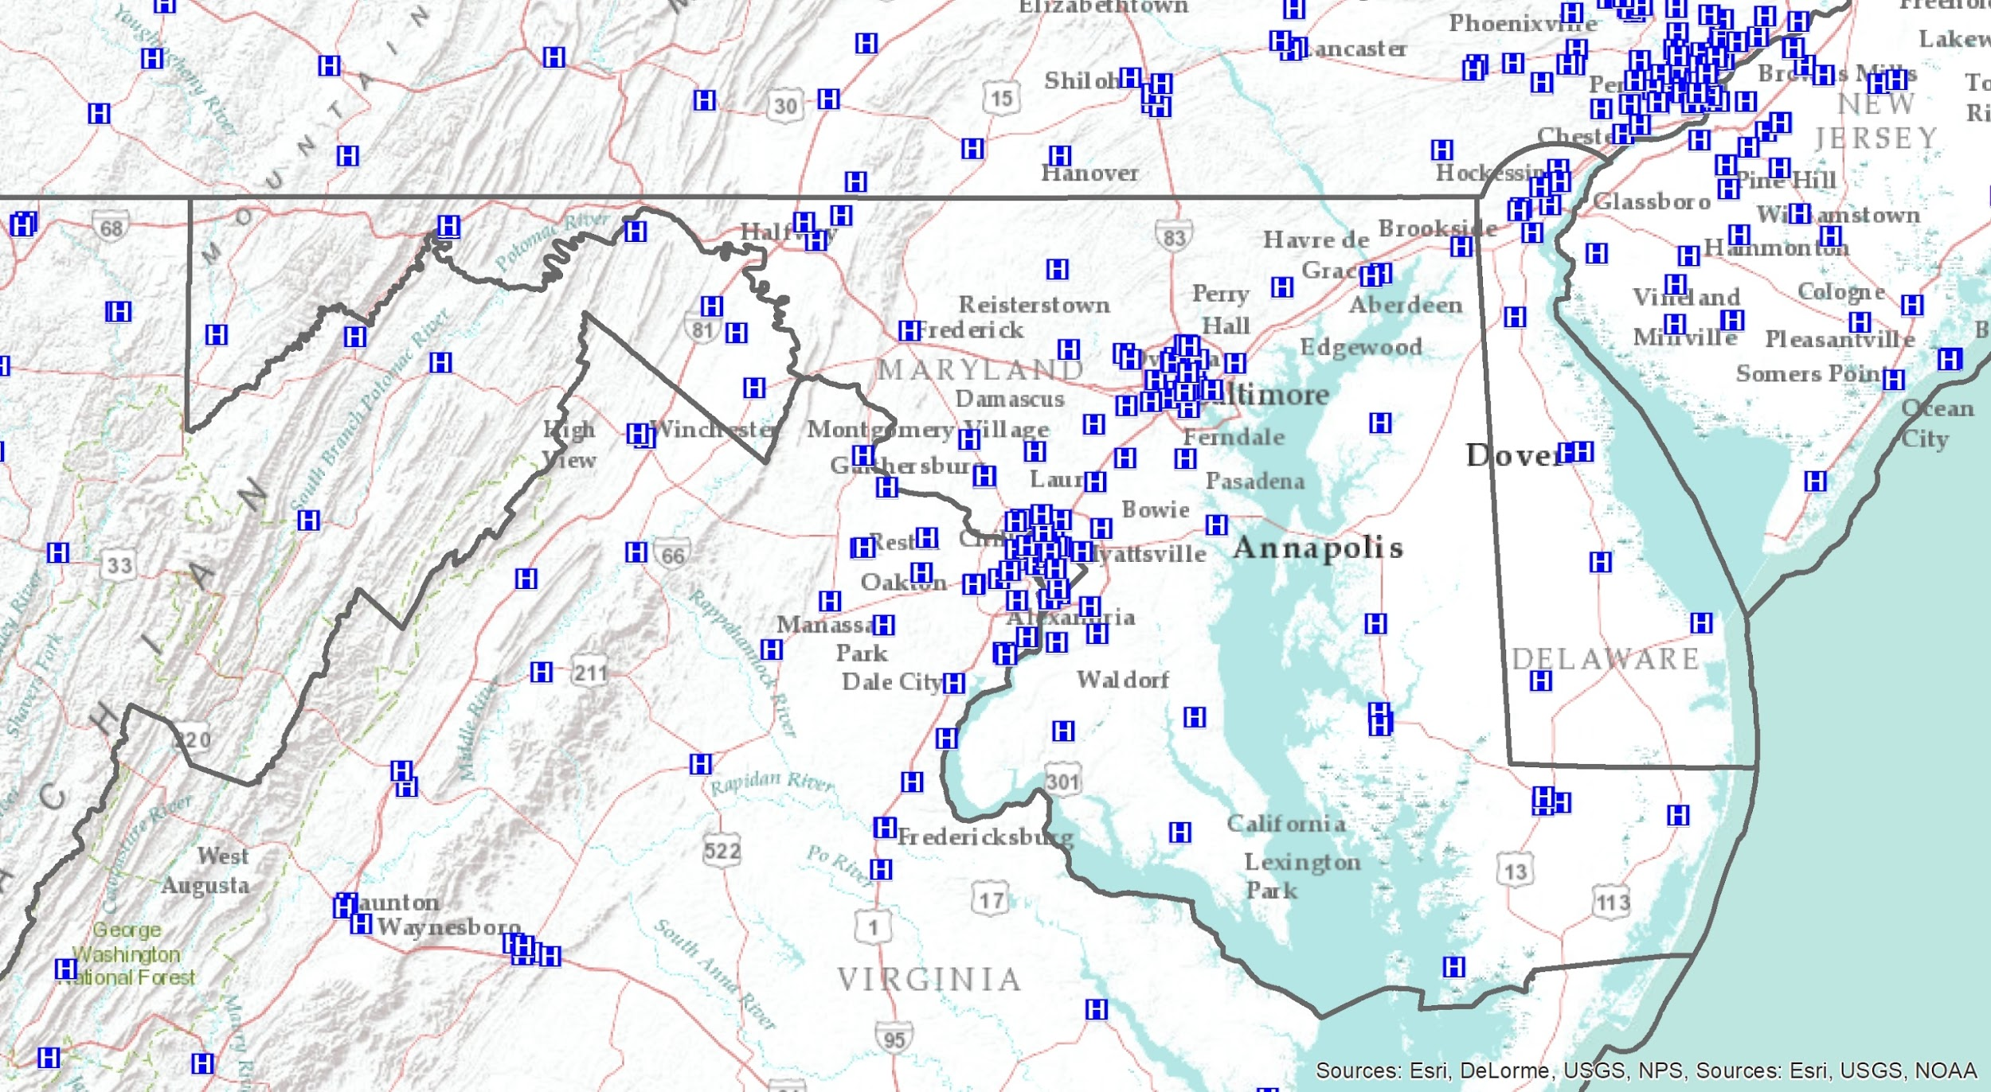
Notes:
Next, let's map all of the hospital locations in Maryland.

Slide 20
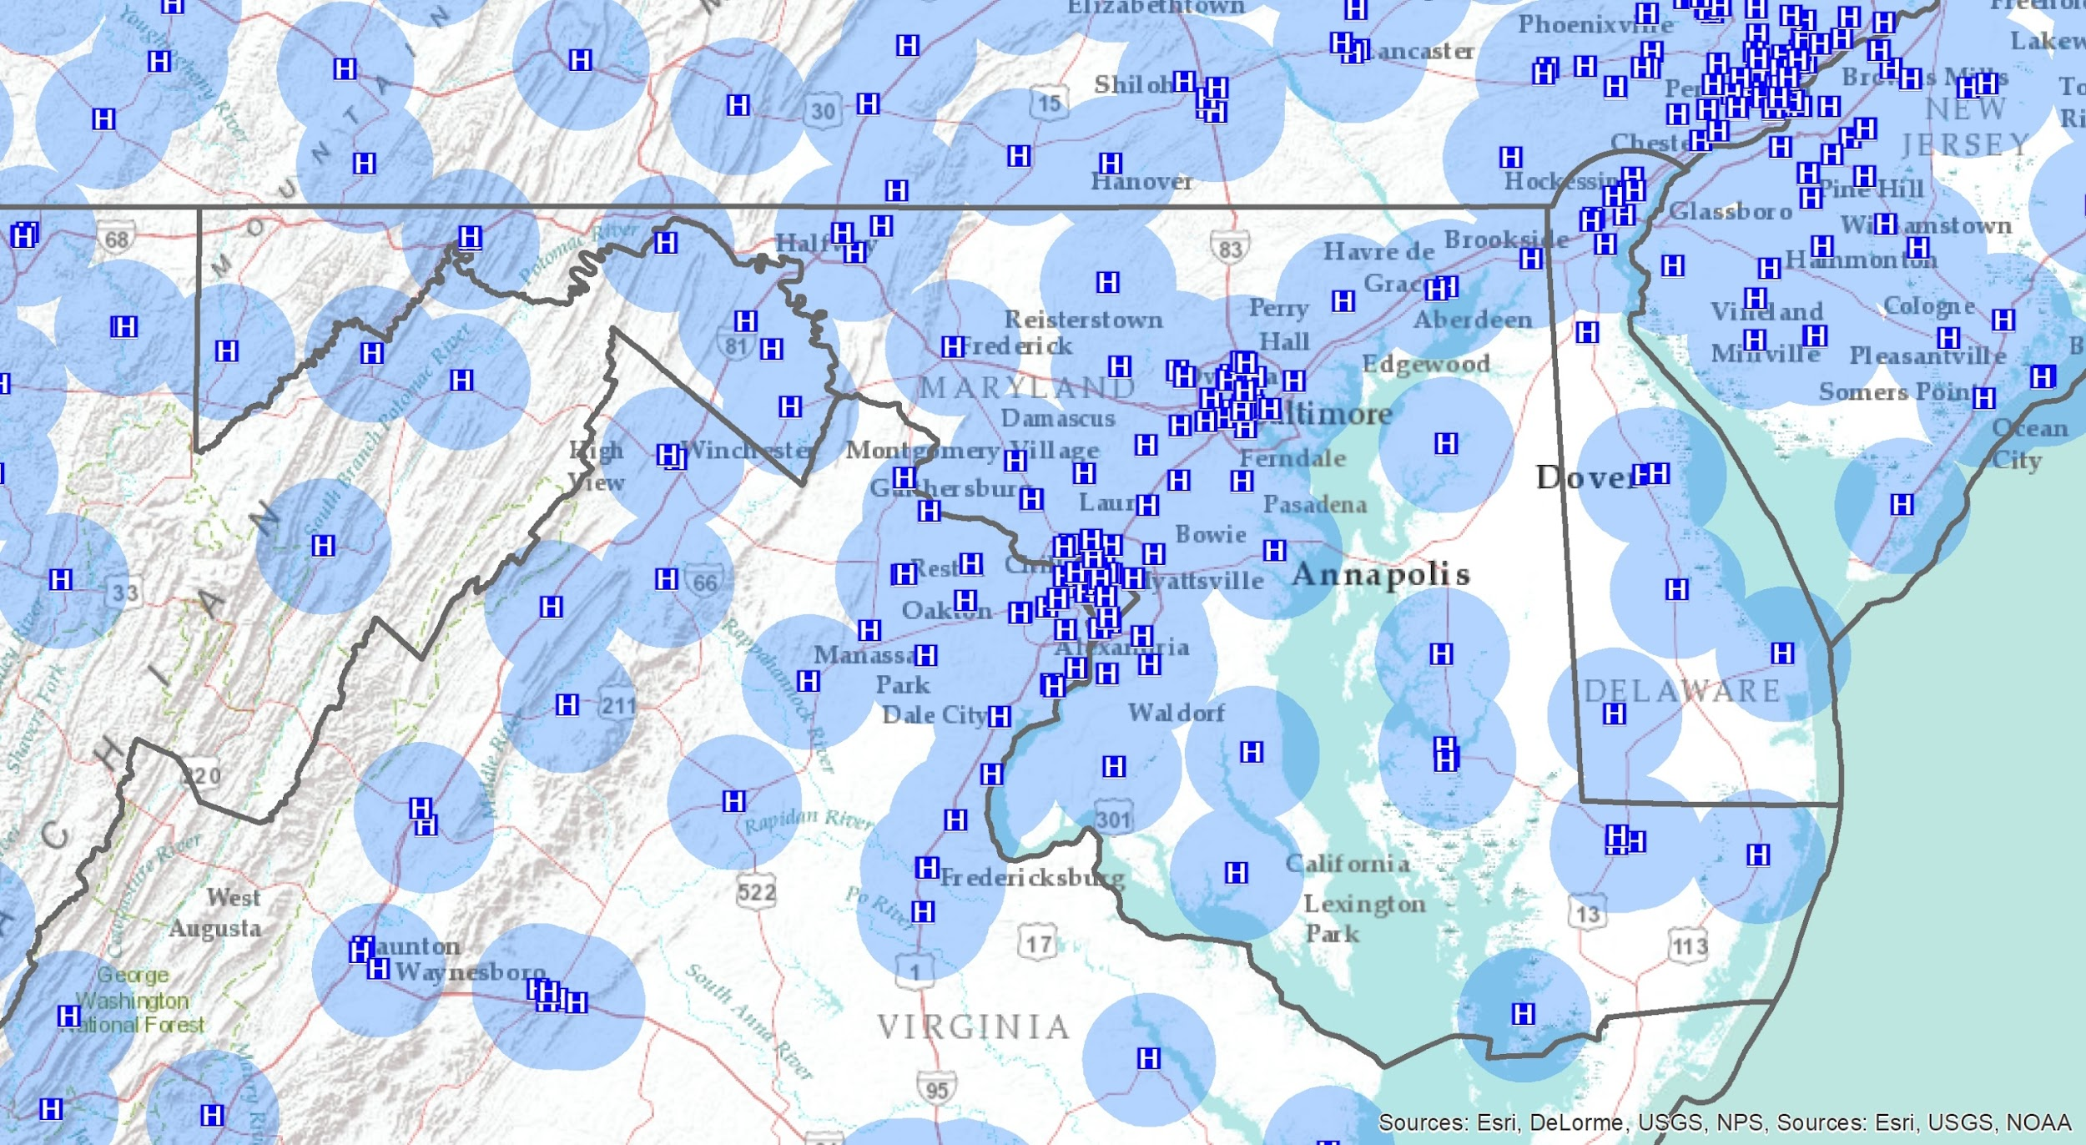
Notes:
Now let’s add a 5 mile buffer around each hospital to show service coverage.

Slide 21
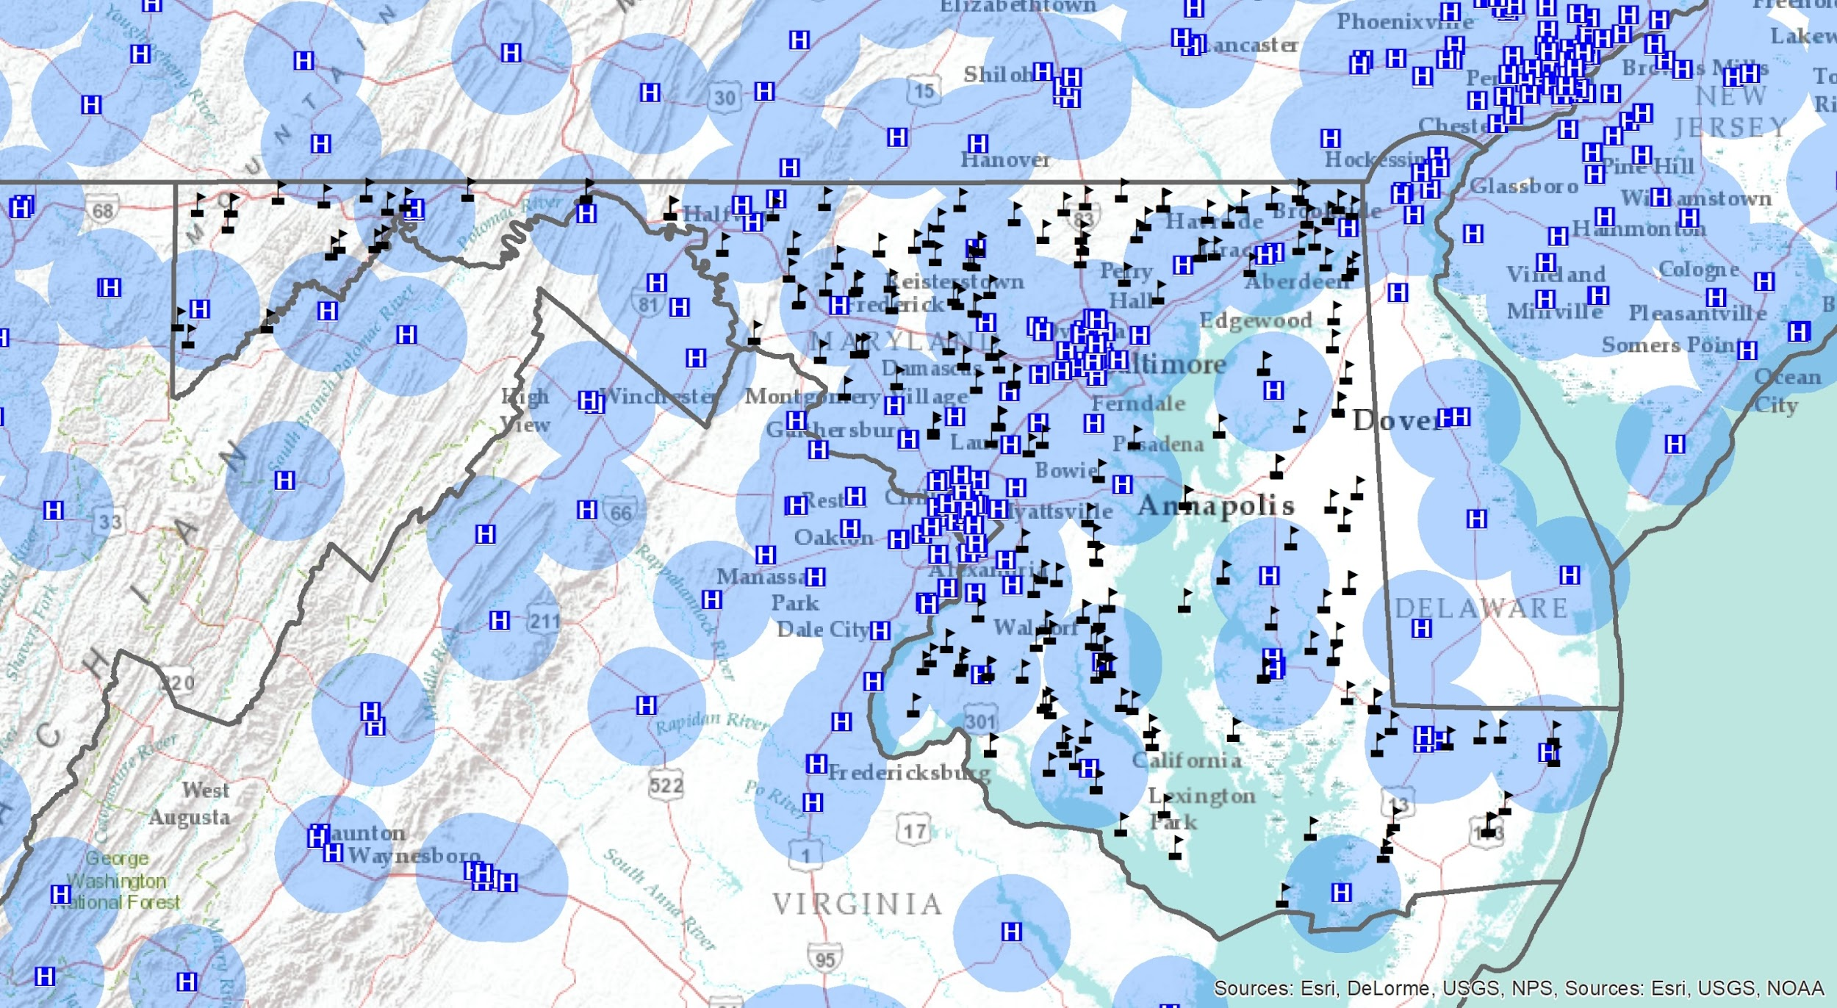
Notes:
Now, let's map all of the elementary and middle schools in Maryland.

Slide 22
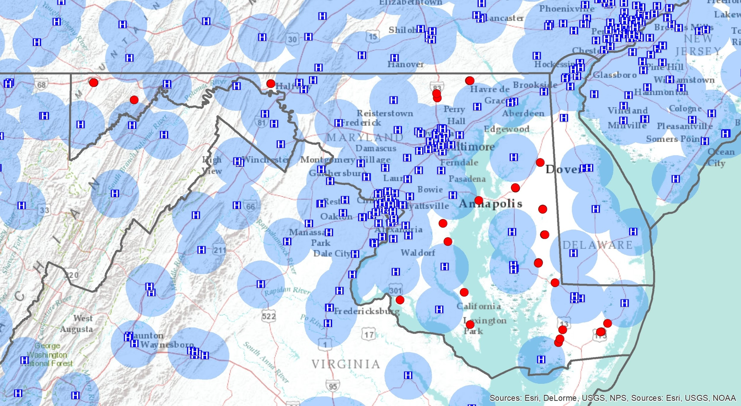
Notes:
Finally, let’s use GIS analysis to find the rural schools that fall outside of hospital coverage. These schools are at higher risk for concussion issues due to being outside of hospital coverage.

Slide 23
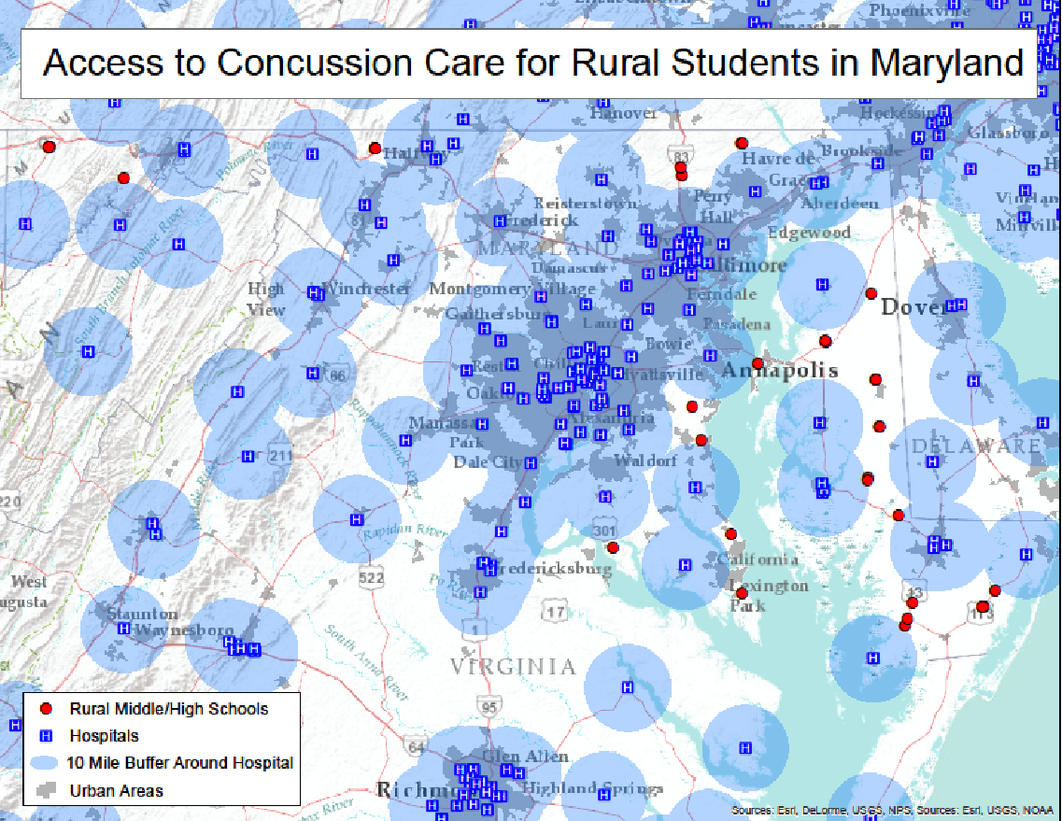
Notes:
This is a finalize illustration showing the access to concussion care for rural students in Maryland.

Slide 24
How will You use Data to Spark Action in Your Community?
Notes:
Pose the question to the audience challenging them to use data to spark action in their community

Slide 25
Finding the Root Cause
Through Tree Activity, we are going to start finding relationships between Health Factors and Health Outcomes
We are going to analyze the data to find areas of concern and strength
From these areas of concern, we are going to look for “seeds” that we can plant to move to action!
Notes:
Read Slide discussing the Tree Activity - an interactive activity on using the County Health Rankings data

Slide 26
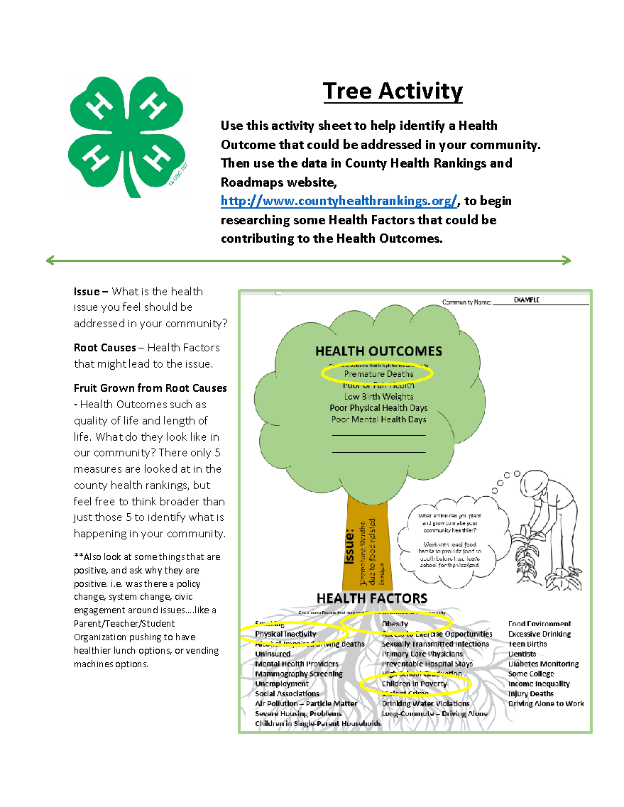
The Tree Model
Branches – Look for Health Outcomes
Trunk – Pick an Issue in Your County
Roots – Look for Health Factors
Seeds – Action Items to Tackle Issue
Notes:
Read Slide discussing each component of the tree

Slide 27
Find Data
Analyze Data
Understand Data
Move to Action from Data
Notes:
Read Slide

Slide 28
How will You use Data to Spark Action in Your Community?
Notes:
Read Slide

Slide 29
Thank You!
Notes:
End of Presentation

